Slide 1
CodeBascics Resume Challenge
Provide insights to Management in consumer goods domain
Submitted by:Shashank Prakash Patil

Slide 2
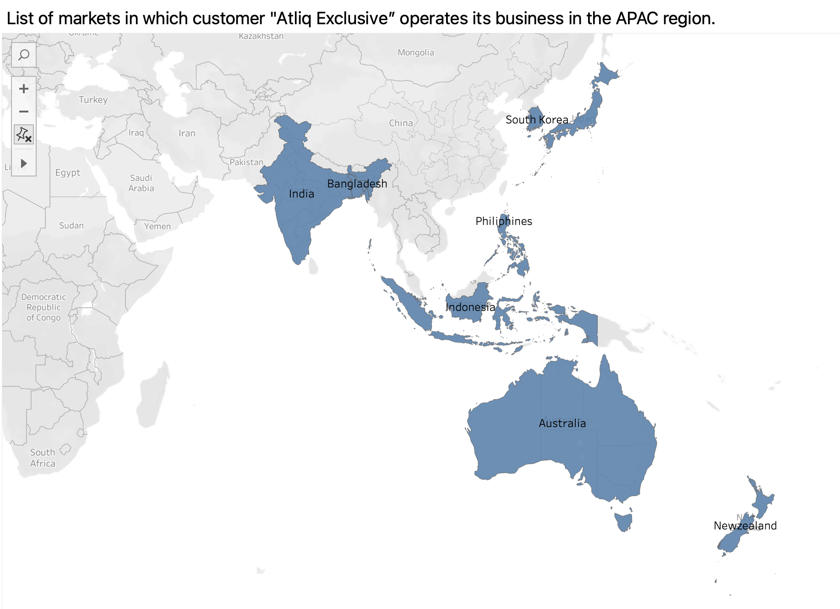
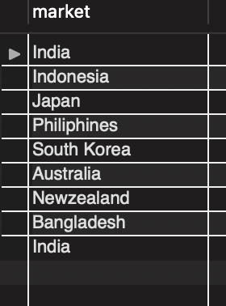
1)Provide the list of markets in which customer "Atliq Exclusive” operates its business in the APAC region.
Insights
The markets in which customer "Atliq Exclusiveoperates its business in the APAC region are India,Indonesia,Japan,Philiphines,South Korea,Australia,Newzealand,Bangladesh,India

Slide 3
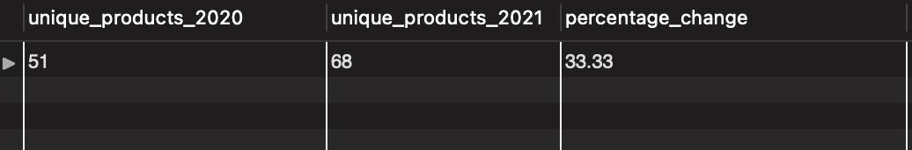
2)What is the percentage of unique product increase in 2021 vs. 2020?
Insights
Results indicate that the number of Unique products in 2021 has been increased by 33.33% compared to 2020

Slide 4
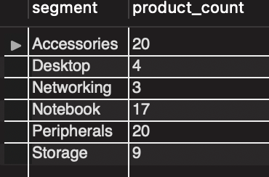
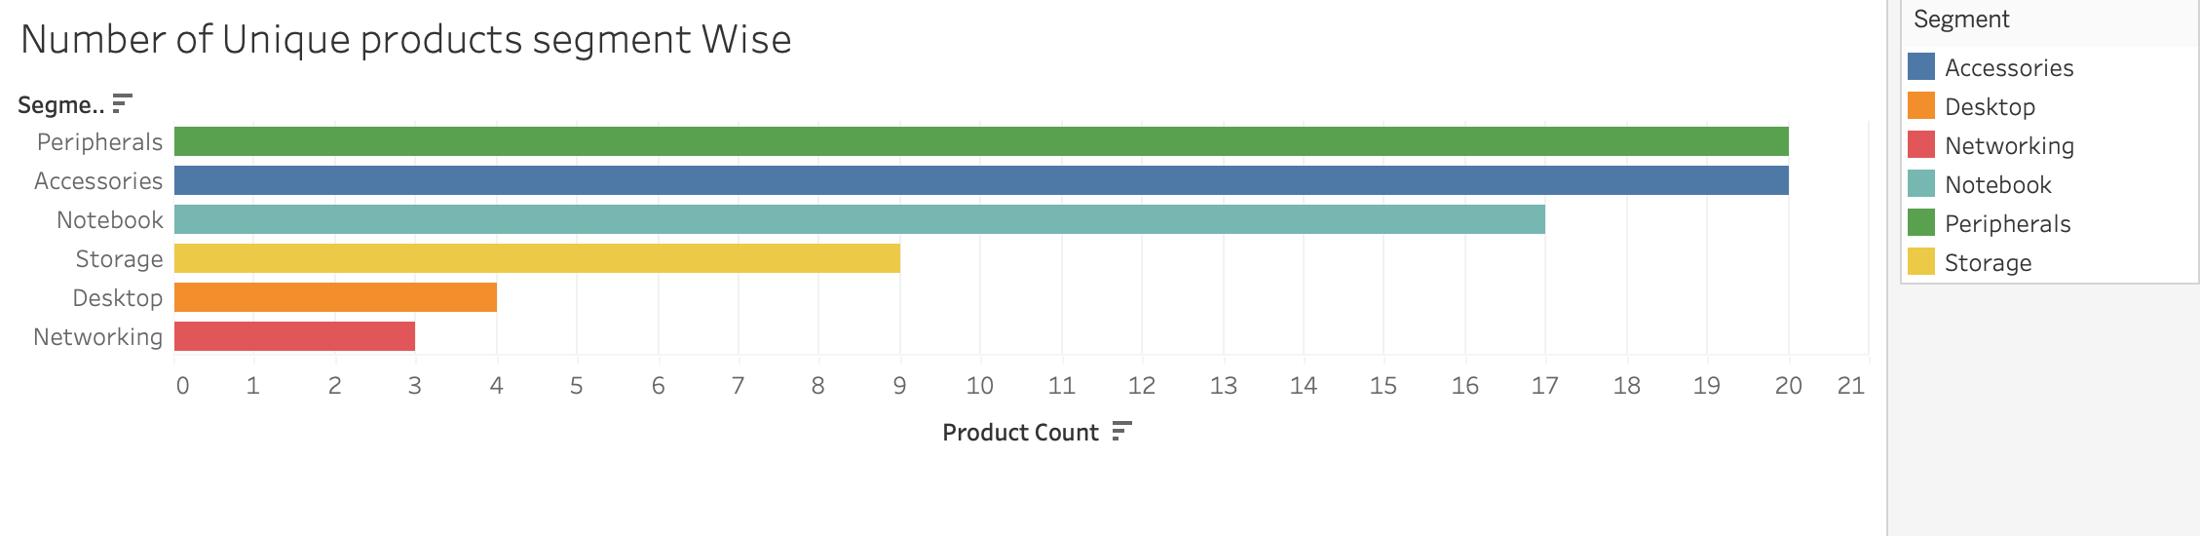
3) Provide a report with all the unique product counts for each segment and sort them in descending order of product counts.
Insights
1)The accessories segment has the highest product_count of 20
2)The storage segment gas the lowest product_count of 9

Slide 5
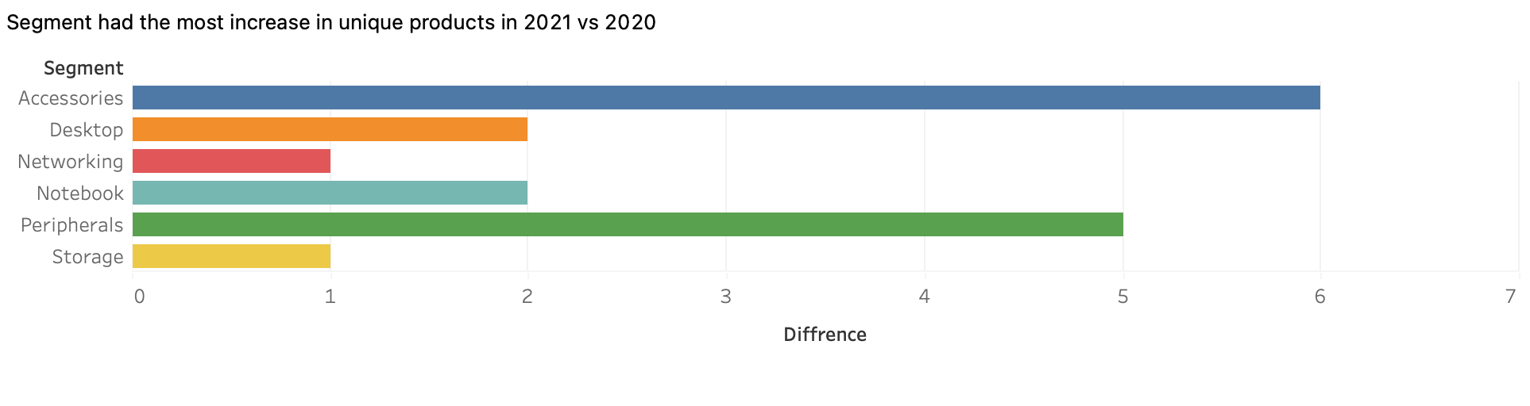
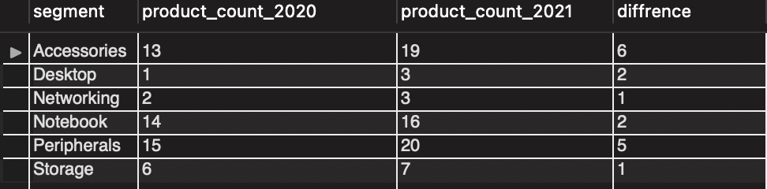
4) Which segment had the most increase in unique products in 2021 vs 2020?
Insights
1)Accesories segment had the most increase in unique products by 6 products

Slide 6
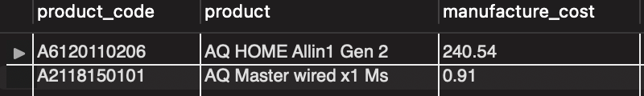
5) Get the products that have the highest and lowest manufacturing costs
Insights:
1)AQ Home Allin Gen2 has the highest manufacturing cost of 240.54
2)AQ Master wired x1 Ms has the lowest manufacturing cost of 0.91

Slide 7
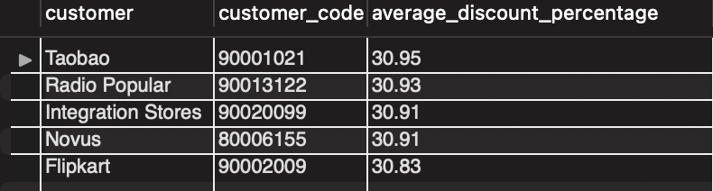
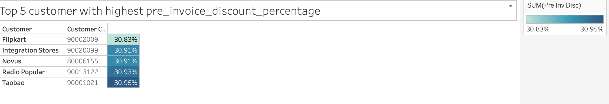
6) Generate a report which contains the top 5 customers who received an average high pre_invoice_discount_pct for the fiscal year 2021 and in the Indian market.
Insights
1)The top 5 custoemrs who received average high pre invoice discount percentage are Taobao , Radio Popular, Integartion Stores, Novus and Flipkart

Slide 8
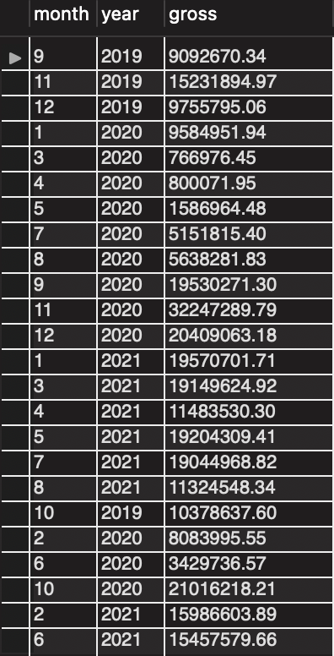
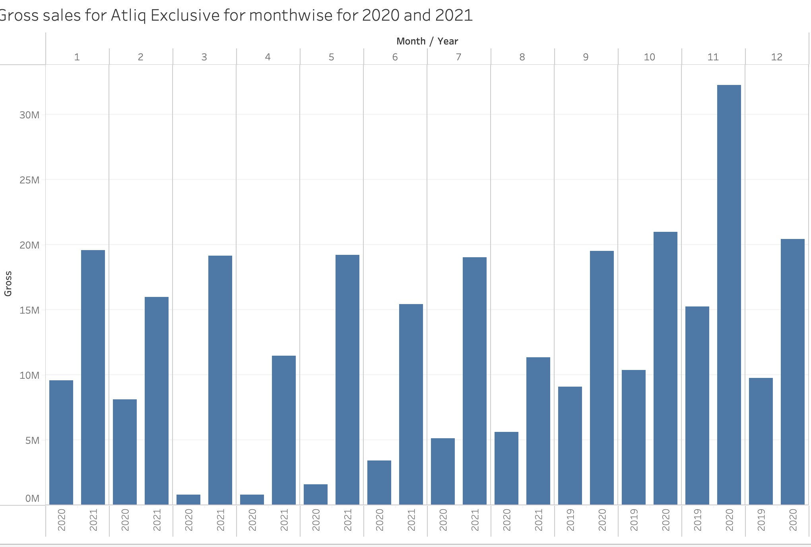
7)Get the complete report of the Gross sales amount for the customer “Atliq Exclusive” for each month. This analysis helps to get an idea of low and high-performing months and take strategic decisions.
Insights
1)The Gross sales in 2021 is more than 2020 from January to August
2)The Gross sales in 2020 is more than 2019 in the month of September to December

Slide 9
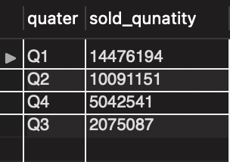
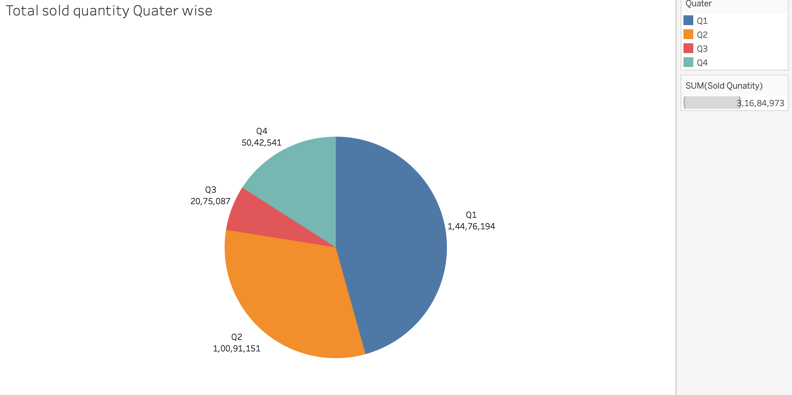
8)In which quarter of 2020, got the maximum total_sold_quantity?
Insights
Q1 of 2020 has the highest number of sold_qunatity
Q3 of 2020 has the lowest number of sold_quantity

Slide 10
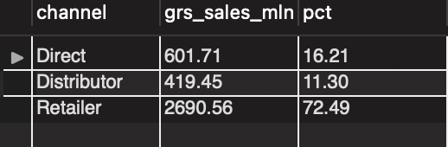
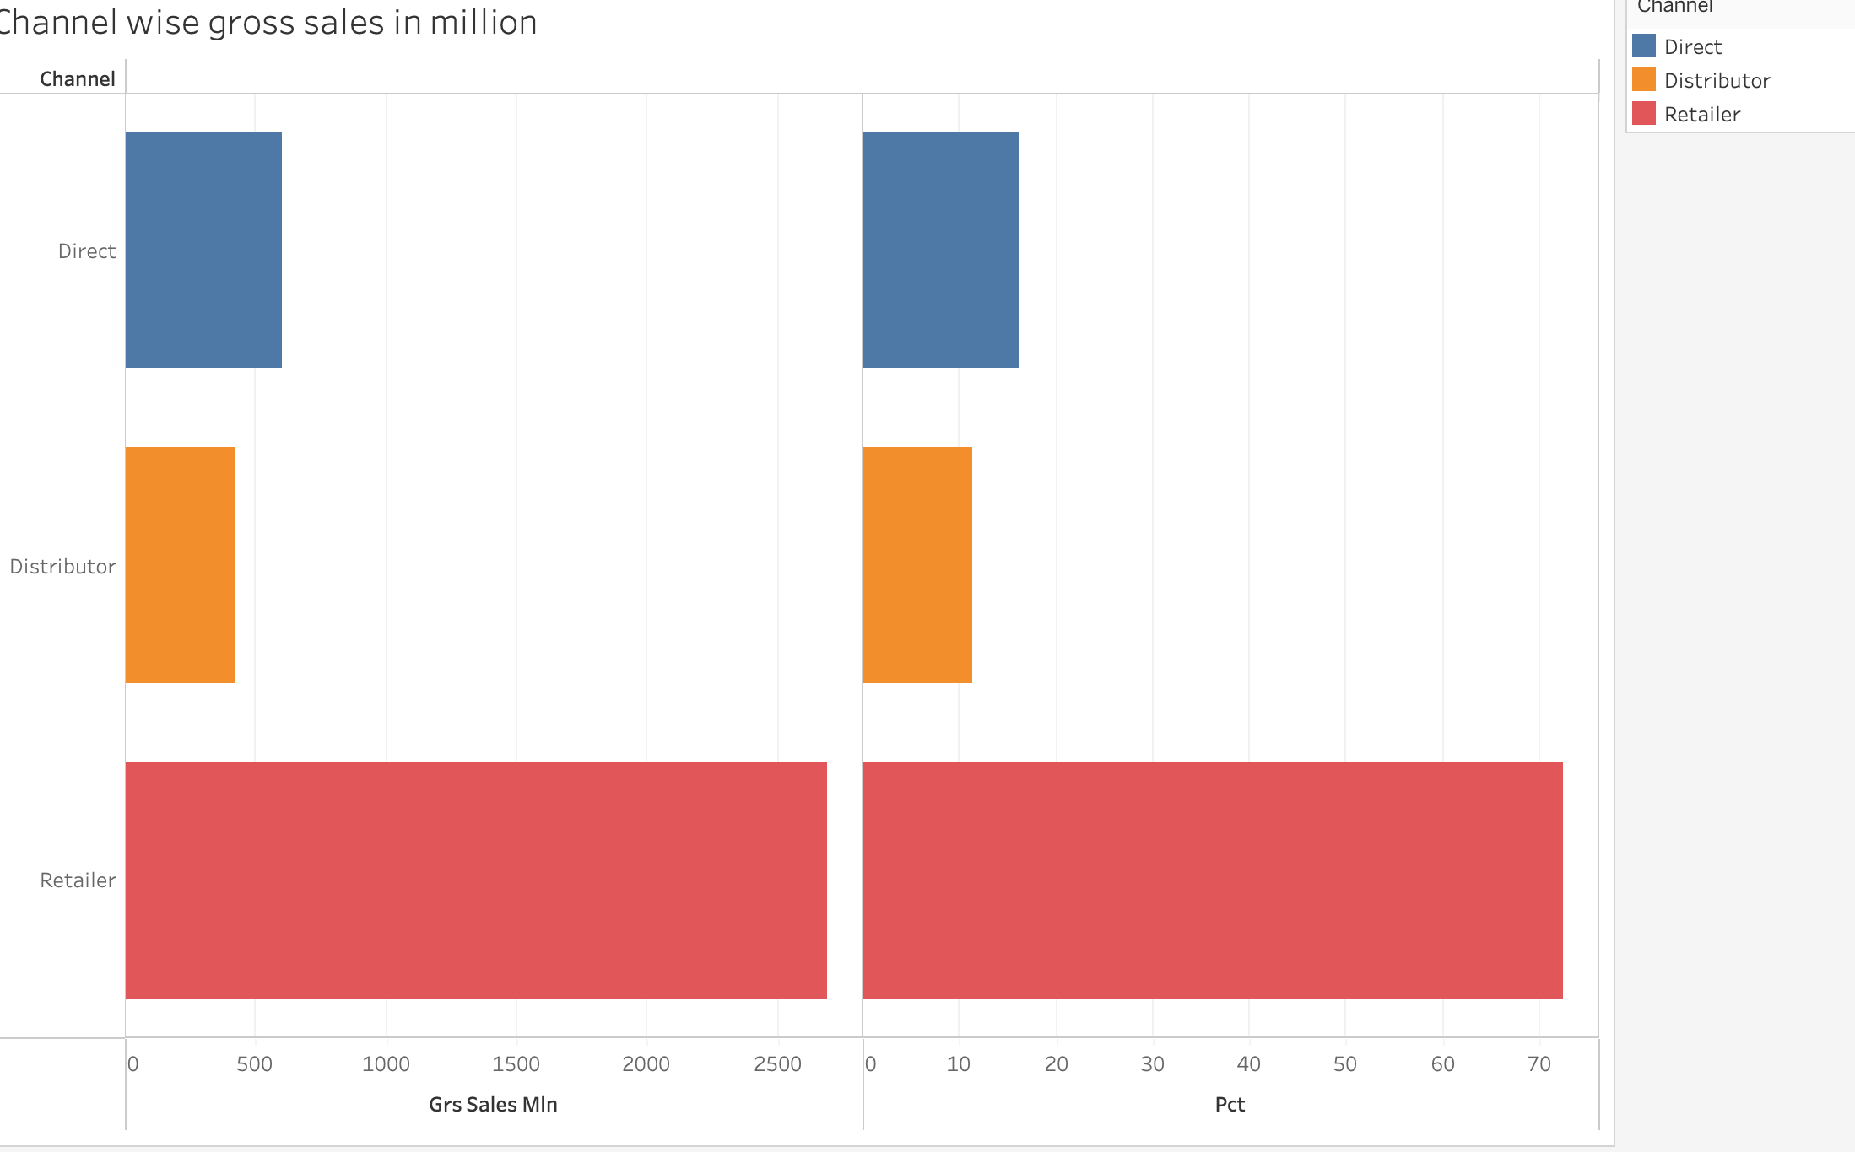
9) Which channel helped to bring more gross sales in the fiscal year 2021 and the percentage of contribution?
Insights
Retailer channel helped to bring more sales with gross sales of 601.71 million contributing about 72.49 percent of total sales

Slide 11
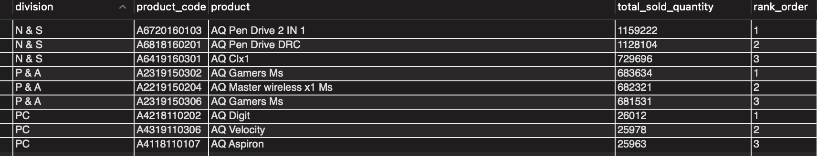
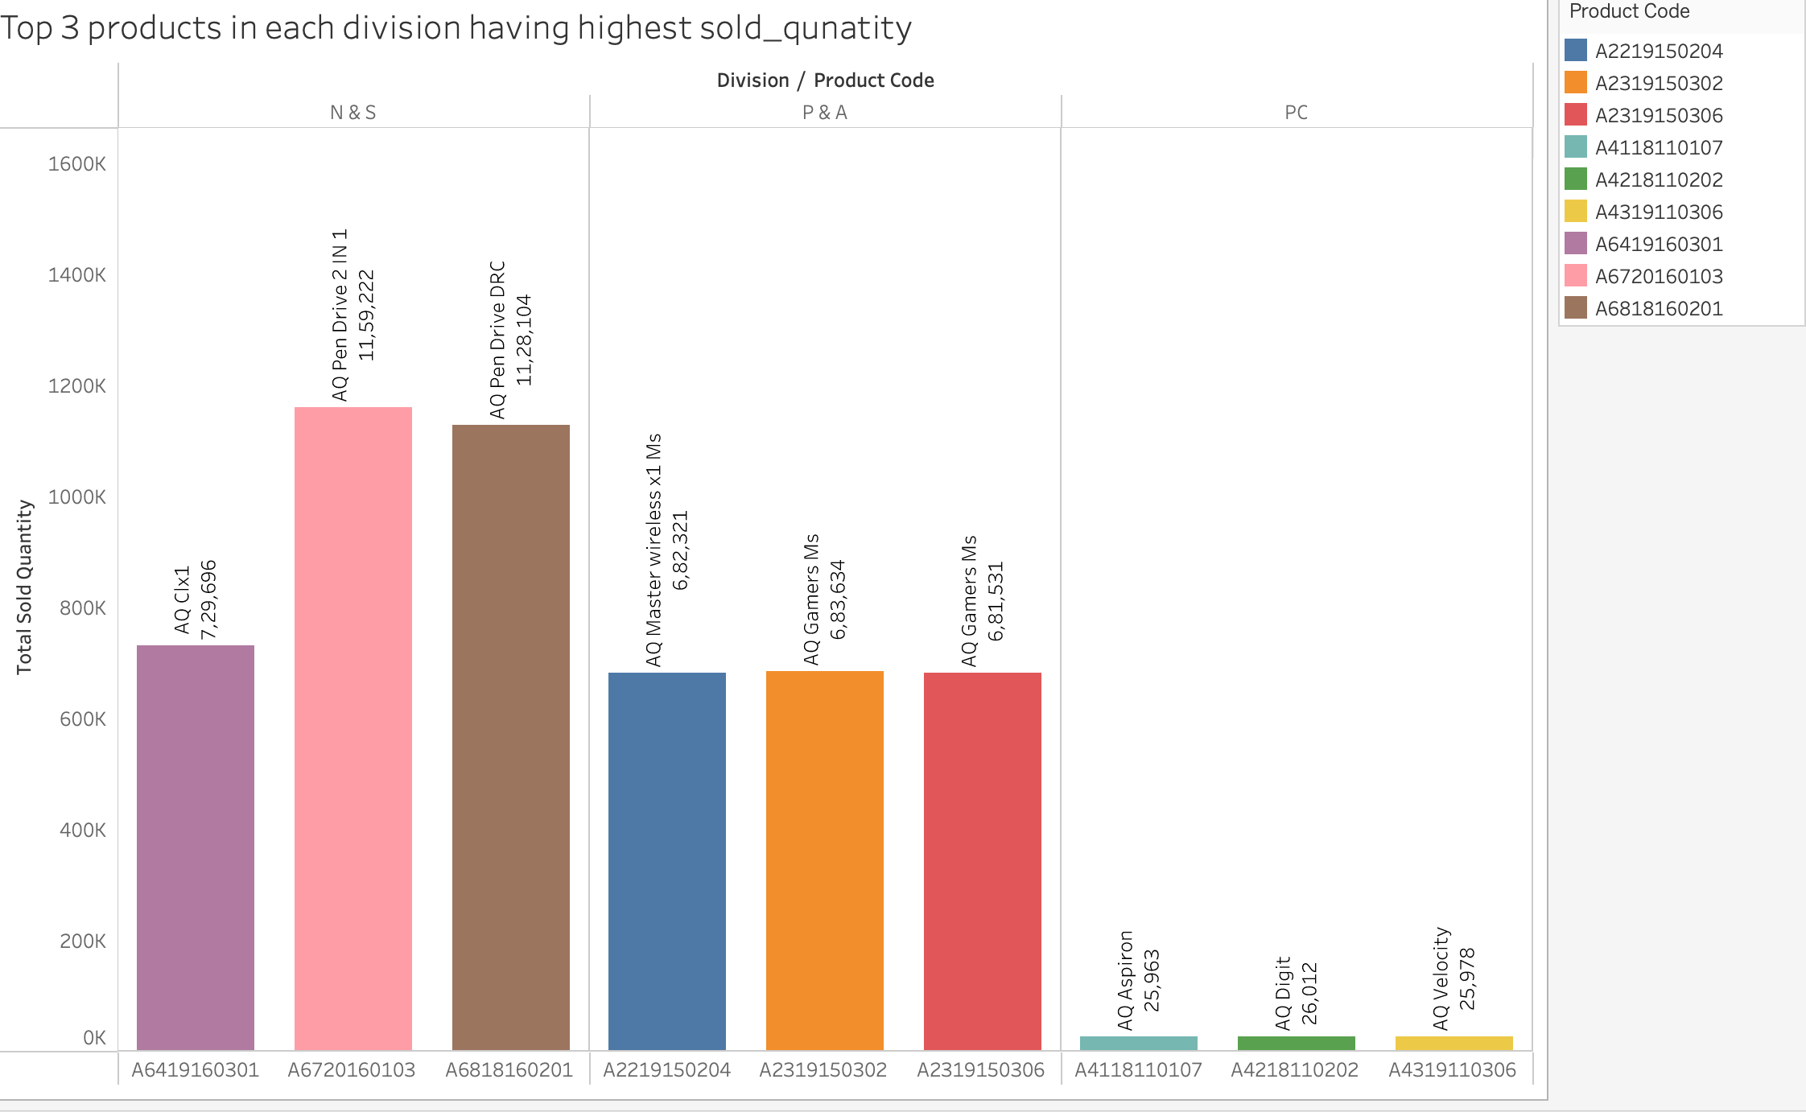
10)Get the Top 3 products in each division that have a high total_sold_quantity in the fiscal_year 2021?
Insights
1)Top 3 products sold in N&S division are AQ pen drive 2 IN 1,AQ Pen Drive DRC,AQ Clx1
2)Top 3 products sold in P&A division are AQ Gamers Ms , AQ Master wireless x1 Ms
3)Top 3 products sold in PC division are AQ Digit, AQ velocity , AQ Aspiron

